Slide 1

Agile Vs. Waterfall Software Development
Group M302:
Amnah Harahsheh|Flor Ardaneh|Sricharan Bonda |
Nazli Khajehamirlou | Jeremy Romana | Sara Sahebjam-Atabaki |
Hari Hara Sudhan Venkateswaran | David Voqui

Slide 2
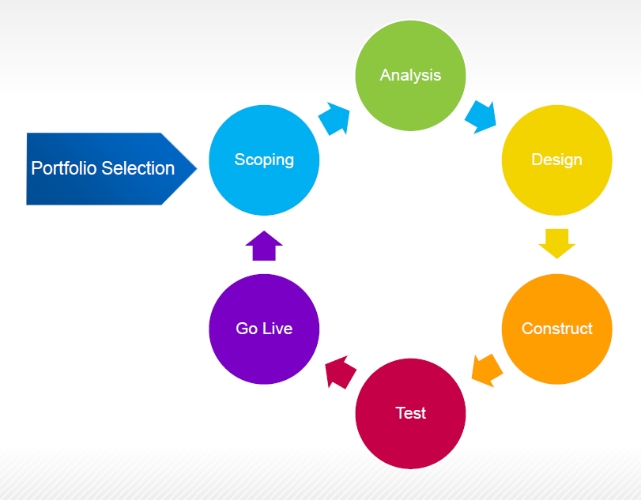
Agile Overview
Cyclical
Responsive to change
Customer Focused
Continuous Improvement
Product over Process
Close Knit Team

Slide 3
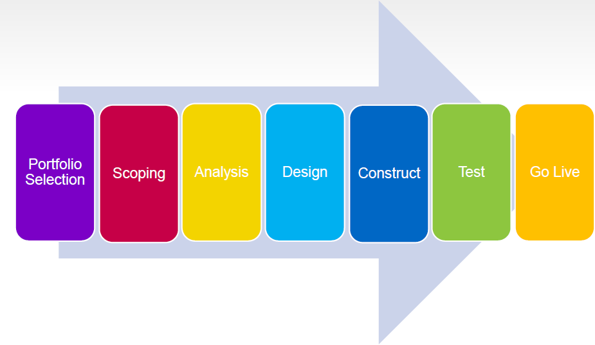
Waterfall Overview
Linear – Phase by phase
Easy to manage
Rigid Documented Approach
Fixed Deliverables at each phase
Lower dependence on individual members

Slide 4
Objective
Gather Model input data
Create Process flow chart using the decision points
Create verification for model
Create a Simulation model for both agile and waterfall methods
Test model using verification for correctness
Create and test three alternate scenarios
Recommend suitable development process for KMM Software

Slide 5
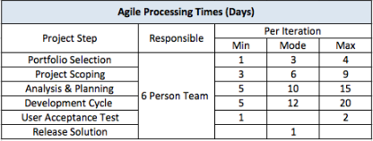
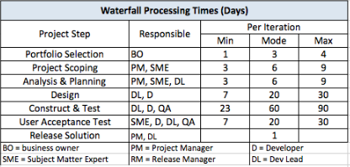
Model Inputs

Slide 6
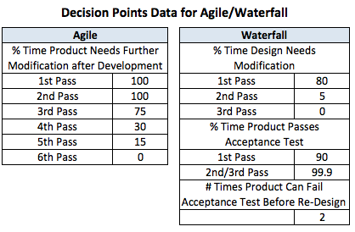
Decision Points

Slide 7
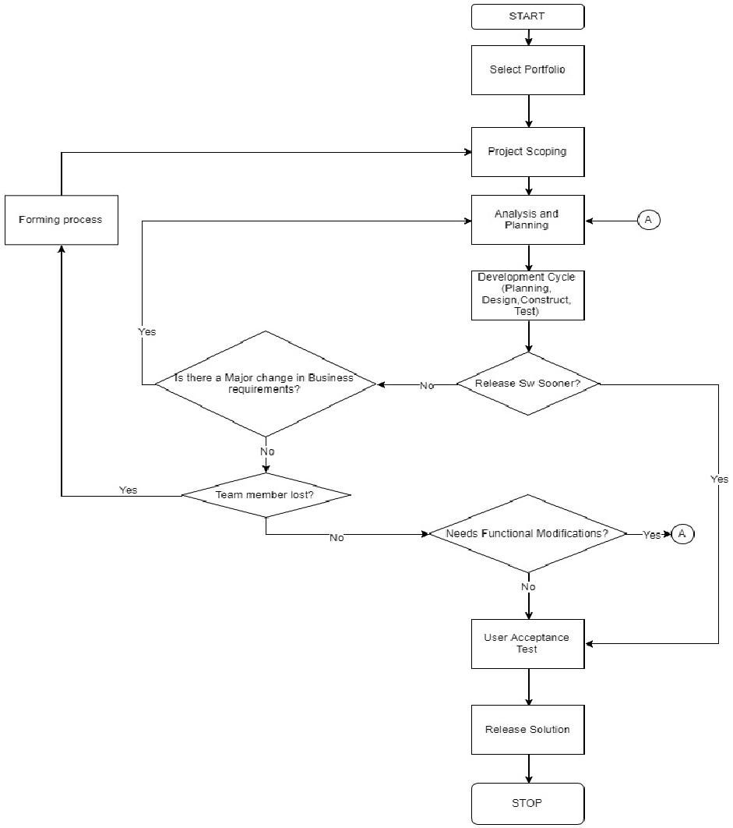
Agile Process Flowchart

Slide 8
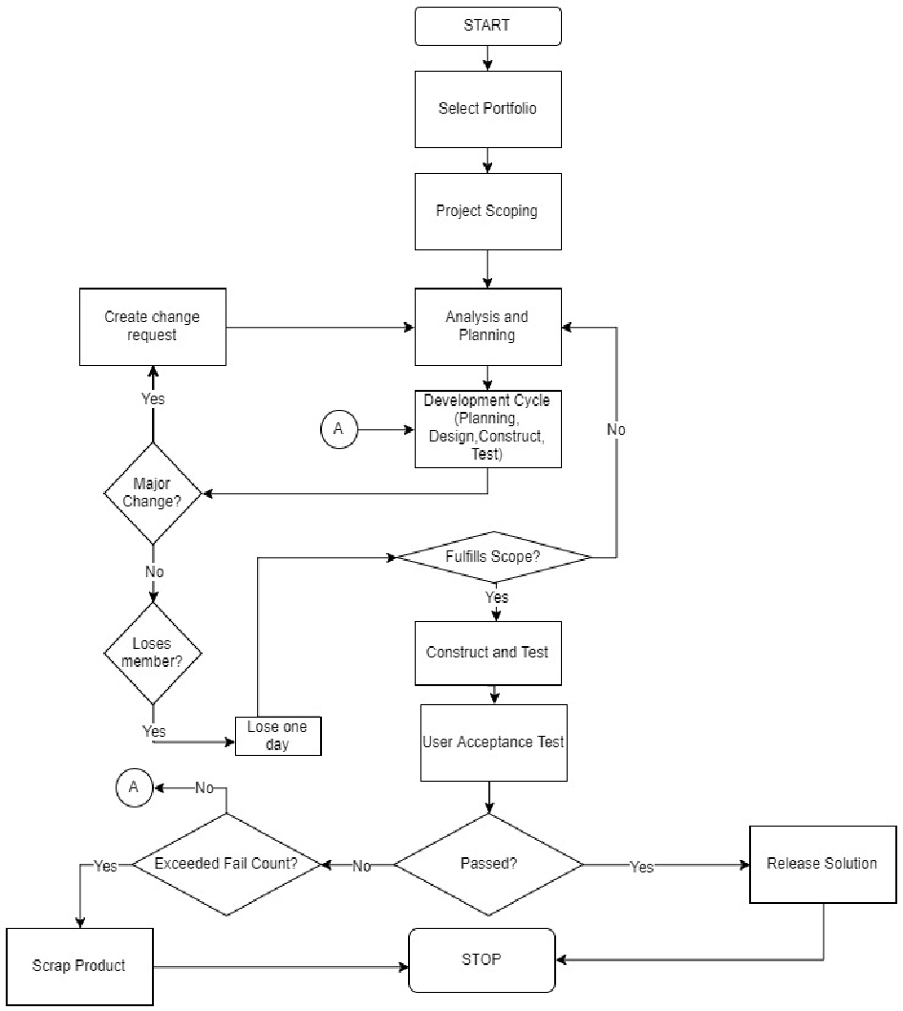
Waterfall Process Flowchart

Slide 9
Performance Metrics
Throughput
Utilization
Cycle Time

Slide 10
Runtime Parameters
Agile
Warmup | Run Time | No. Replications | Thruput (days)
1 month | 6 months | 10 | 82 | 112
2 month | 6 months | 10 | 83 | 103
3 month | 6 months | 10 | 76 | 108
3 month | 1 year | 10 | 71 | 86
 | 2 year | 10 | 85 | 96
 | 3 year | 10 | 87 | 97
 | 4 year | 10 | 88 | 98
 | 5 year | 10 | 91 | 98
 | 6 year | 10 | 93 | 100
 | 7 year | 10 | 92 | 99
 | 8 year | 10 | 92 | 98
 | 9 year | 10 | 94 | 100
 | 10 year | 10 | 94 | 98
3 month | 10 year | 5 | 92 | 100
 |  | 15 | 95 | 98
Waterfall
Warmup | Run Time | No. Replications | Thruput (days)
1 month | 6 months | 10 | 73 | 128
2 month | 6 months | 10 | 69 | 128
3 month | 6 months | 10 | 63 | 133
3 month | 1 year | 10 | 56 | 101
 | 2 year | 10 | 69 | 111
 | 3 year | 10 | 77 | 103
 | 4 year | 10 | 86 | 137
 | 5 year | 10 | 93 | 149
 | 6 year | 10 | 92 | 149
 | 7 year | 10 | 103 | 153
 | 8 year | 10 | 94 | 149
 | 9 year | 10 | 91 | 146
 | 10 year | 10 | 103 | 151
3 month | 10 year | 5 | 77 | 165
 |  | 15 | 103 | 142
Warmup:3 months
Runtime:10 years
No. Replications:15

Slide 11
Verification
Agile Verification
 | Mean Time | Average Cycles | Total number of days
Portfolio Selection | 2.67 | 1.00 | 2.67
Project Scoping | 6.00 | 1.00 | 6.00
Analysis and Planning | 10.00 | 4.01 | 40.09
Design,Construct and Test | 12.33 | 4.01 | 49.44
User Acceptance | 1.50 | 1.00 | 1.50
Release | 1.00 | 1.00 | 1.00
 |  |  | 100.70
Waterfall Verification
 | Mean Values | Number of Cycles | Number of Days
Portfolio Selection | 2.67 | 1.00 | 2.67
Project Scoping | 6.00 | 1.00 | 6.00
Analysis and Planning | 6.00 | 1.84 | 11.04
Design | 12.67 | 1.94 | 24.59
Construct and Test | 35.00 | 1.10 | 38.50
User Acceptance | 8.00 | 1.10 | 8.80
Release | 1.00 | 1.00 | 1.00
 |  |  | 92.60

Slide 12

Base Scenario
 | AGILE - Base Scenario |  |  | WATERFALL - Base Scenario
 | 95% Low | 95% High |  | 95% Low | 95% High
Cycle Time | 97.28 | 101.25 | Cycle Time | 89.53 | 91.10
Throughput | 35.56 | 37.11 | Throughput | 39.68 | 40.19
Agile Resource | 99.60 | 100 | BO | 2.94 | 3.08
 |  |  | PM | 36.76 | 56.34
 |  |  | SME | 40.94 | 58.91
 |  |  | DL | 90.51 | 94.57
 |  |  | D | 77.45 | 81.13
 |  |  | QA | 50.61 | 53.32

Slide 13
Scenario 1 : Major Change in Business Requirement
 | AGILE - Scenario 1 |  |  | WATERFALL - Scenario 1
 | 95% Low | 95% High |  | 95% Low | 95% High
Cycle Time | 96.37 | 100.20 | Cycle Time | 89.16 | 99.62
Throughput | 35.91 | 37.56 | Throughput | 24.50 | 38.30
Agile Resource | 99.75 | 100.00 | BO | 2.96 | 3.09
 |  |  | PM | 33.83 | 57.55
 |  |  | SME | 38.28 | 60.24
 |  |  | DL | 89.68 | 94.62
 |  |  | D | 77.29 | 86.17
 |  |  | QA | 51.61 | 68.40

Slide 14
Scenario 2: Change in release date
 | AGILE - Scenario 2 |  |  | WATERFALL - Scenario 2
 | 95% Low | 95% High |  | 95% Low | 95% High
Cycle Time | 90.15 | 90.23 | Cycle Time | 89.35 | 90.56
Throughput | 41 | 41 | Throughput | 40.67 | 41.06
Agile Resource | 63.92 | 64.41 | BO | 2.93 | 3.07
 |  |  | PM | 20.02 | 20.9
 |  |  | SME | 27.21 | 28.02
 |  |  | DL | 70.25 | 73.08
 |  |  | D | 56.95 | 60.01
 |  |  | QA | 30.83 | 34.76

Slide 15
Scenario 3 : Change in Team Composition
 | AGILE - Scenario 3 |  |  | WATERFALL - Scenario 3
 | 95% Low | 95% High |  | 95% Low | 95% High
Cycle Time | 112.40 | 114.89 | Cycle Time | 89.69 | 97.13
Throughput | 31.06 | 31.88 | Throughput | 24.37 | 39.50
Agile Resource | 99.99 | 100.00 | BO | 2.94 | 3.10
 |  |  | PM | 35.04 | 60.34
 |  |  | SME | 38.91 | 62.61
 |  |  | DL | 90.40 | 95.11
 |  |  | D | 77.64 | 86.49
 |  |  | QA | 50.61 | 68.41

Slide 16
Analysis
Base Scenario
Waterfall method has a lower cycle time resulting in a higher throughput.
Agile method has a higher cycle time resulting in lower throughput and the addition of a higher queue time for subsequent projects.
Scenario 1
Waterfall method’s cycle time is lower than Agile despite having to go back to project scoping. This is due in part to the number of cycles that the project goes through in Agile. On an average, project on agile goes through 4 cycles while in Waterfall, the average number of cycles is 2.
Scenario 2
The Agile method goes through lower number of cycles in this scenario allowing for a faster cycle time. In Waterfall, since construct and test is the stable cut off point, the reduction in cycle time is not significant. Agile’s iterative approach to product development helps deliver the product faster in this scenario.
Scenario
Agile is significantly slowed down due to the additional wait time for forming process and the need to go back to project scoping, thereby losing progress in project development.
Waterfall is not significantly affected by the loss of a team member and so its cycle time is only slightly longer than the base scenario.

Slide 17
Conclusion
Waterfall
AGILE
Lower Cycle time
Lower impact due to change in team composition in the team.
Major change in the business requirement does not adversely affect the Waterfall method’s cycle time or throughput.

Slide 18
Thank You!

